Slide 1
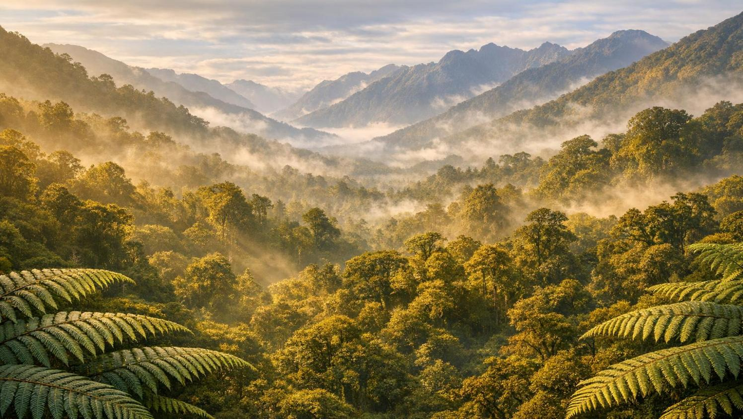
ProGuides NZ / Kaiārahi Aotearoa
More Than a Tour Guide
Becoming an Ambassador for Aotearoa New Zealand
Outreach Programme 2026

Slide 2
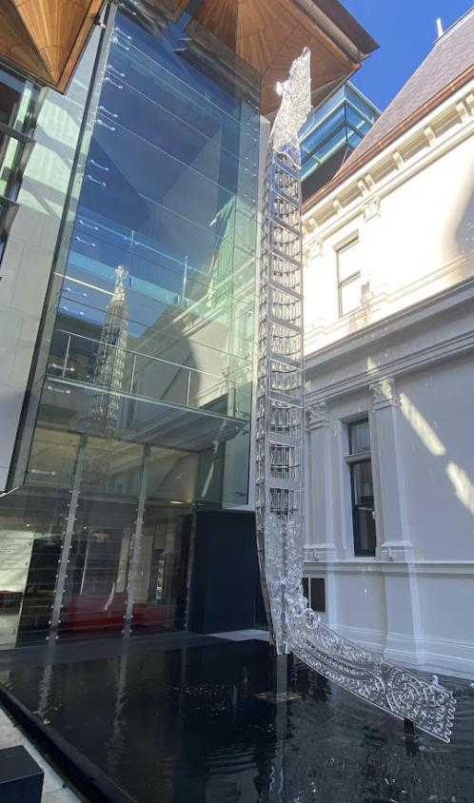
What does a guide / kaiārahi actually do?
More than just talking on a bus
Roles: storyteller, host, teacher, leader, organiser, problem-solver, sometimes driver/interpreter
Guides bridge the gap between visitors and the destination
Key difference: Information vs. Interpretation

Slide 3
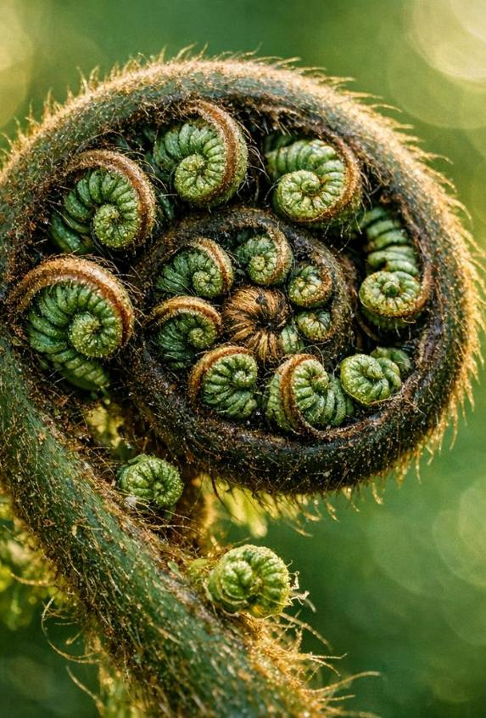
Why guiding is exciting
Every day and group is different
Work in diverse locations (Auckland, Rotorua, Dunedin, Queenstown, etc.)
Interact with visitors from all over the world
Constant learning: culture, history, geography, nature, current events
Requires curiosity and adaptability
Not a holiday – challenges vs professionalism

Slide 4
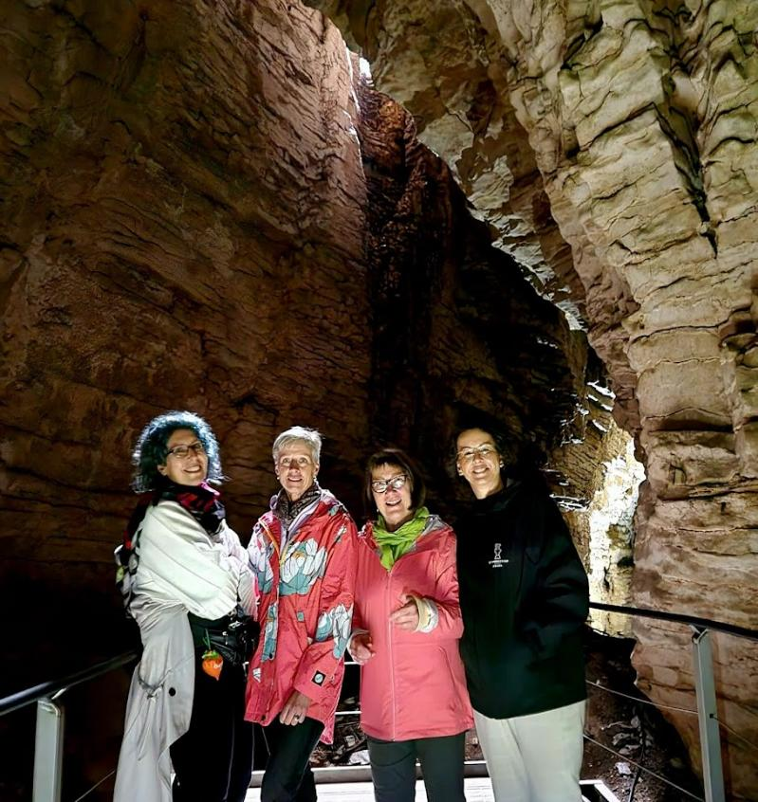
Skills and Qualities of a Professional Guide
Knowledge, skills, and attitude are all essential
Communication: clear, adaptable, engaging
Organisation: manage logistics smoothly
Leadership: confident, clear, friendly
Empathy: notice and support guests’ needs
Cultural sensitivity: respect for Māori culture and local customs
Safety: always a priority
Resilience: stay calm and professional under pressure

Slide 5
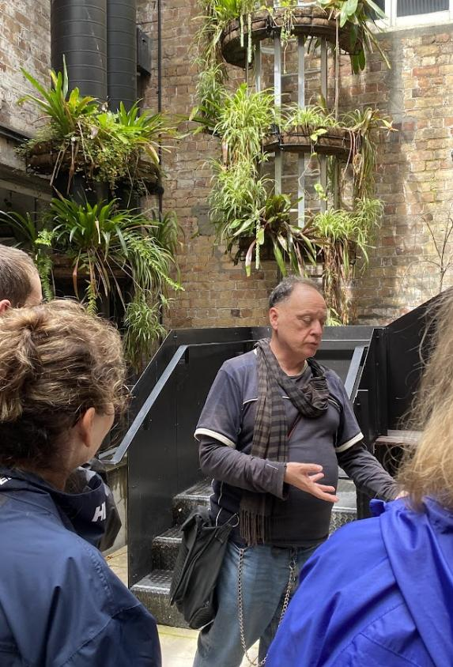
ProGuides NZ and Professionalism
ProGuides: professional association for tour guides, driver guides and small tour operators
Supports independent, seasonal, and specialist guides
Promotes guiding as a profession, not just a casual job
Guides represent the company, destination, community, and New Zealand
Key qualities: knowledge, communication, organisation, leadership, empathy, confidence, safety, professionalism
Professional guiding is a craft that requires ongoing development

Slide 6
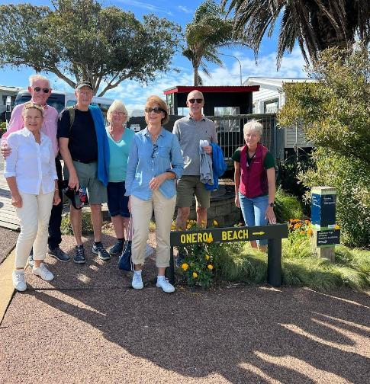
You can start now to build your guiding career!
Start with your backyard: learn its stories and significance
Practise speaking and storytelling
Study Māori place names
Build knowledge step by step (choose one place to start)
Develop people skills: listen, observe, adapt.
Learn from professionals: network, ask questions, attend training
Guiding is a combination of many skills, and we never stop learning

Slide 7
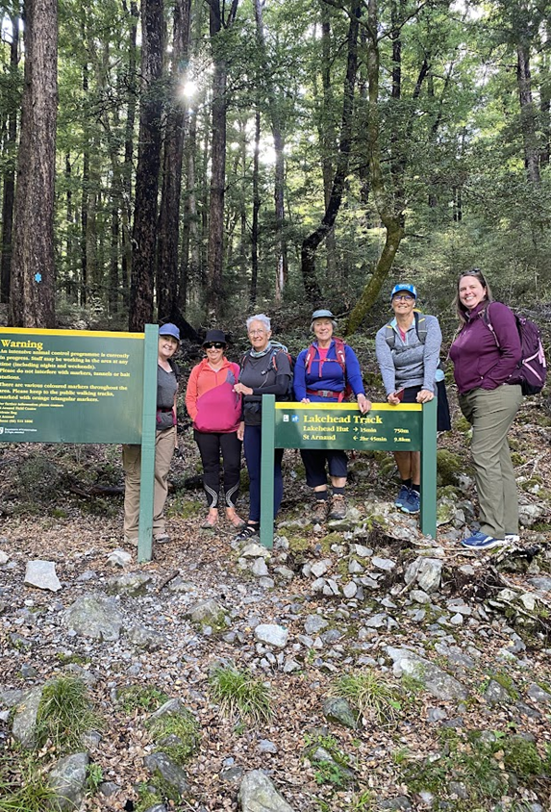
Thanks for your attention!
Q&A
Aotearoa New Zealand:
  Has extraordinary places! We need people who can interpret them with care, respect and skill
  Needs passionate, ethical, well-trained professional guides
A good guide shows visitors where they are – shares information.
An ambassador helps them understand why it matters – shares connection.

Slide 8




The Tiaki Promise
A Commitment to Care for Aotearoa — For Now and Future Generations
Protect Nature
Travel Safely
Show Respect
Lead by Example
Tread lightly, leave no trace. Care for land, sea, and nature.
Show care and consideration for all. Be prepared and responsible.
Travel with an open heart and mind. Honour culture and community.
As ambassadors, model the Tiaki Promise for every visitor you guide.
Created by seven NZ organisations including Tourism New Zealand, Air New Zealand, and the Department of Conservation

